Slide 1



Green Inventors
Innovations in Carbon FootPrint Reduction
Selecting Heavy Electric Vehicle

Slide 2

Problem Statement
Effective way to reduce Carbon footprint in the environment .

Slide 3
Address the Need of the Problem
Increase of Air pollution which results in airborne diseases and toxic air inhalation.
Result of Acid rains in heavy polluted area.
Decreasing non -renewable source in the earth .

Slide 4
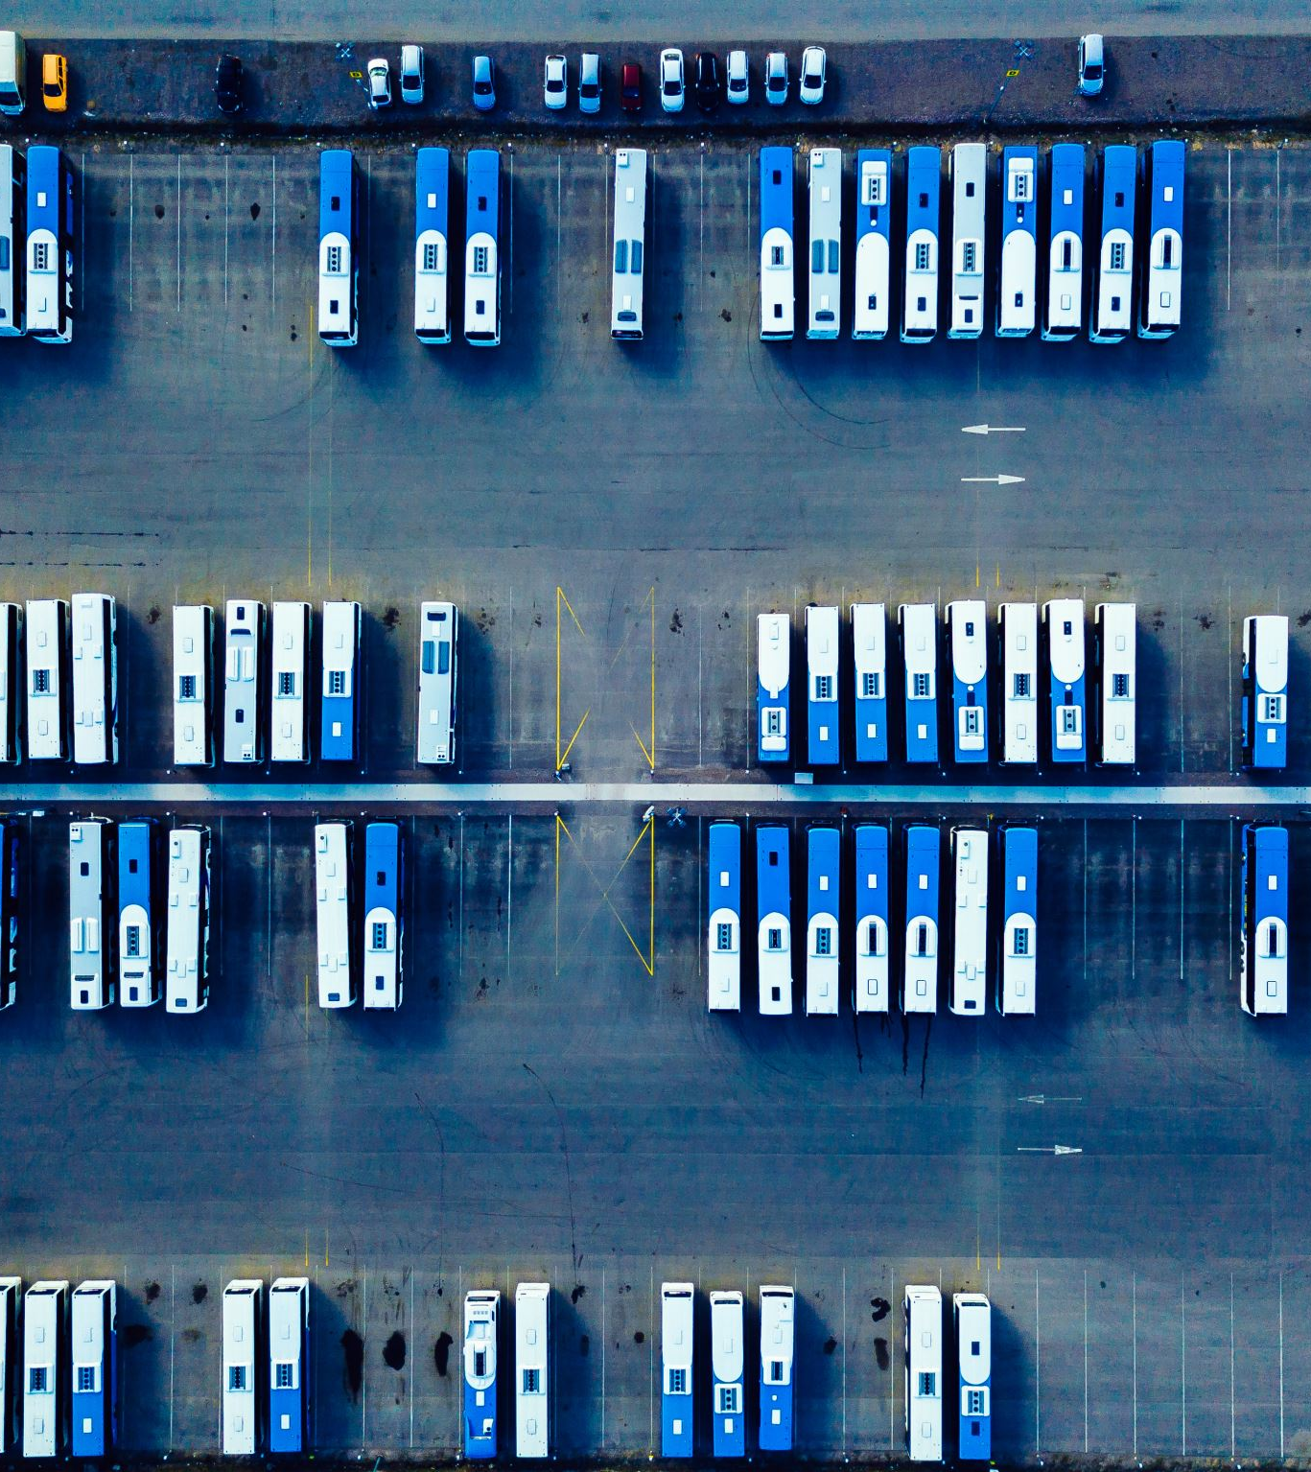
Distinctive Features of the Solution
The Solution that we provide is to change the heavy transportation vehicle like bus, trucks to E -vehicle.
Majority of this vehicles eliminates high amount of green house gases in the environment.
By applying this solution in PUBLIC TRANSPORTION, we can effectivety reduce carbon footprints
Increase in E- vehicles in society encourages peoples to move on to electric vehicles.

Slide 5
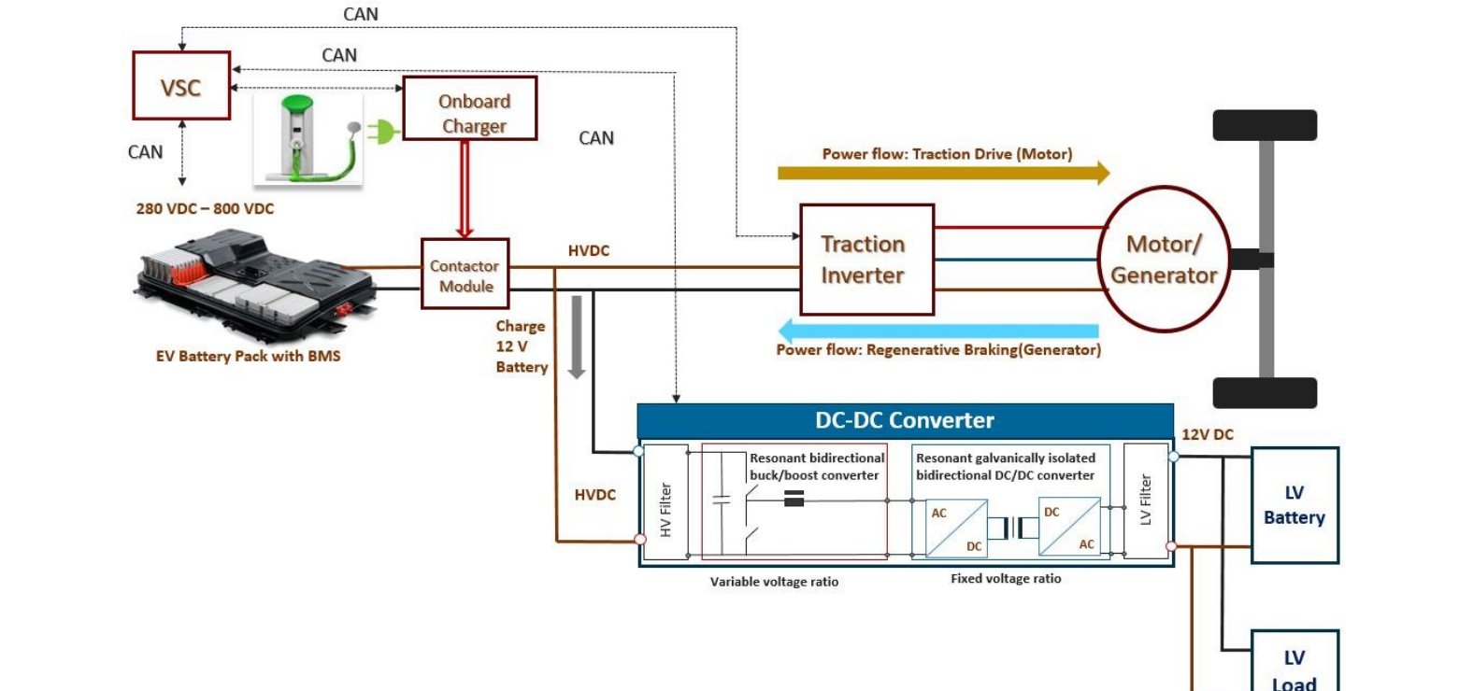

Slide 6
IPR Component
Most of the patent right for E- VEHICLE in India are owned by HONDA and TOYATO.
Reference: https://evreporter.com/patents-and-technology-trends-in-ev-powertrain/

Slide 7
References
1.https://thewire.in/energy/world-energy-outlook-report-2022 (Report on non – renewable energy in India)
2. https://www.iea.org/reports/india-energy-outlook-2021/energy-in-india-today( survey of energy used through India)
3. https://www.cnbc.com/2020/06/30/tesla-and-the-science-of-low-cost-next-gen-ev-million-mile-battery.html ( Report provided by e-vehicle research in TESLA)

